Slide 1
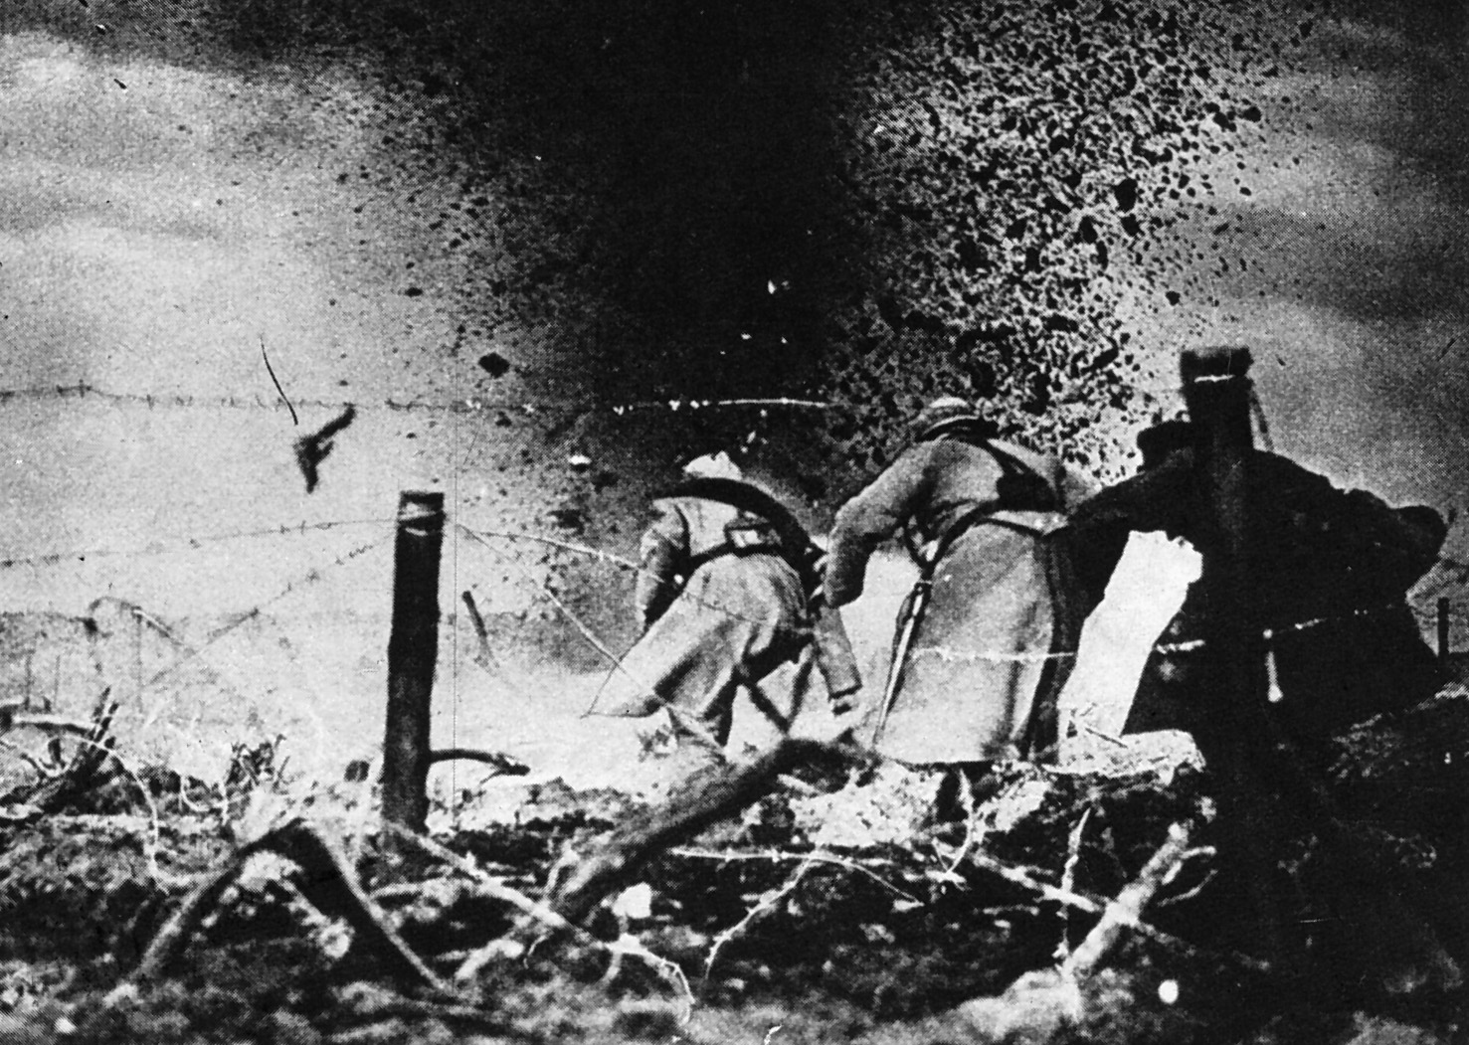
Chapter 25
Imperialism, Alliances, and War

Slide 2
Expansion of European Power and the New Imperialism
The growth of national states permitted Western nations to deploy their resources more effectively than ever before.
Europeans considered their civilization and way of life superior to all others.
The dominant doctrine of free trade opposed political interference in foreign lands as economically unprofitable.
New Imperialism
  During the last third of the nineteenth century, European nations rapidly extended their control over the rest of the globe.

Slide 3
The New Imperialism
Imperialism
  Establishing authority over another nation by exercising economic and political force or by territorial acquisition.
European nations would arrange with other countries to invest capital in undeveloped regions.
European nations could also exert more direct political control.

Slide 4
Motives for the New Imperialism
Economic motives cannot account for the entire impetus behind New Imperialism.
Social Darwinist groups claimed Europeans had an obligation to civilize “backward” peoples.
Religious groups agitated for the spread of Christianity.
Some suggested imperialism be used to attract attention away from social policy.

Slide 5
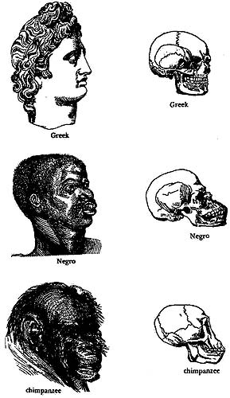
Social Darwinism

Slide 6
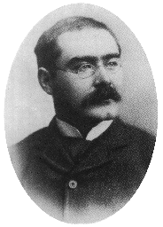
The “White Man’s Burden”
Rudyard Kipling

Slide 7
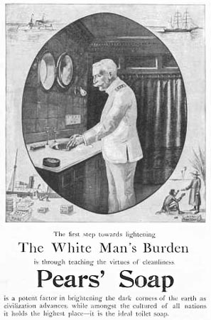
The “White Man’s Burden”?

Slide 8
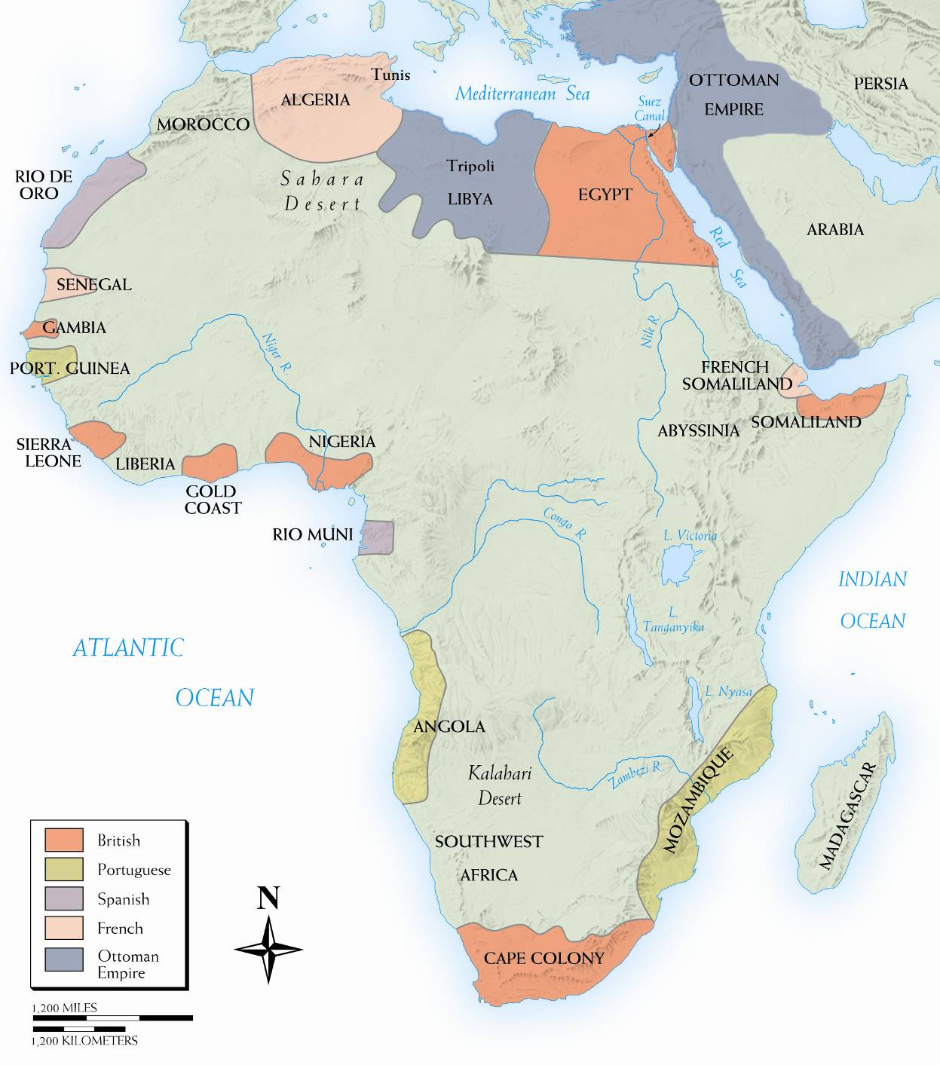
The Scramble for Africa
Between the late 1870s and 1900 European powers divided the entire continent among themselves, motivated by economic and political competition.
The nations used a variety of rationalizations to justify their actions.
Important African raw materials include ivory, rubber, minerals, diamonds, and gold.
Berlin Conference
  Mapped out which European nation had access to certain parts of Africa.
European nations appointed administrators to supervise their African possessions.

Slide 9
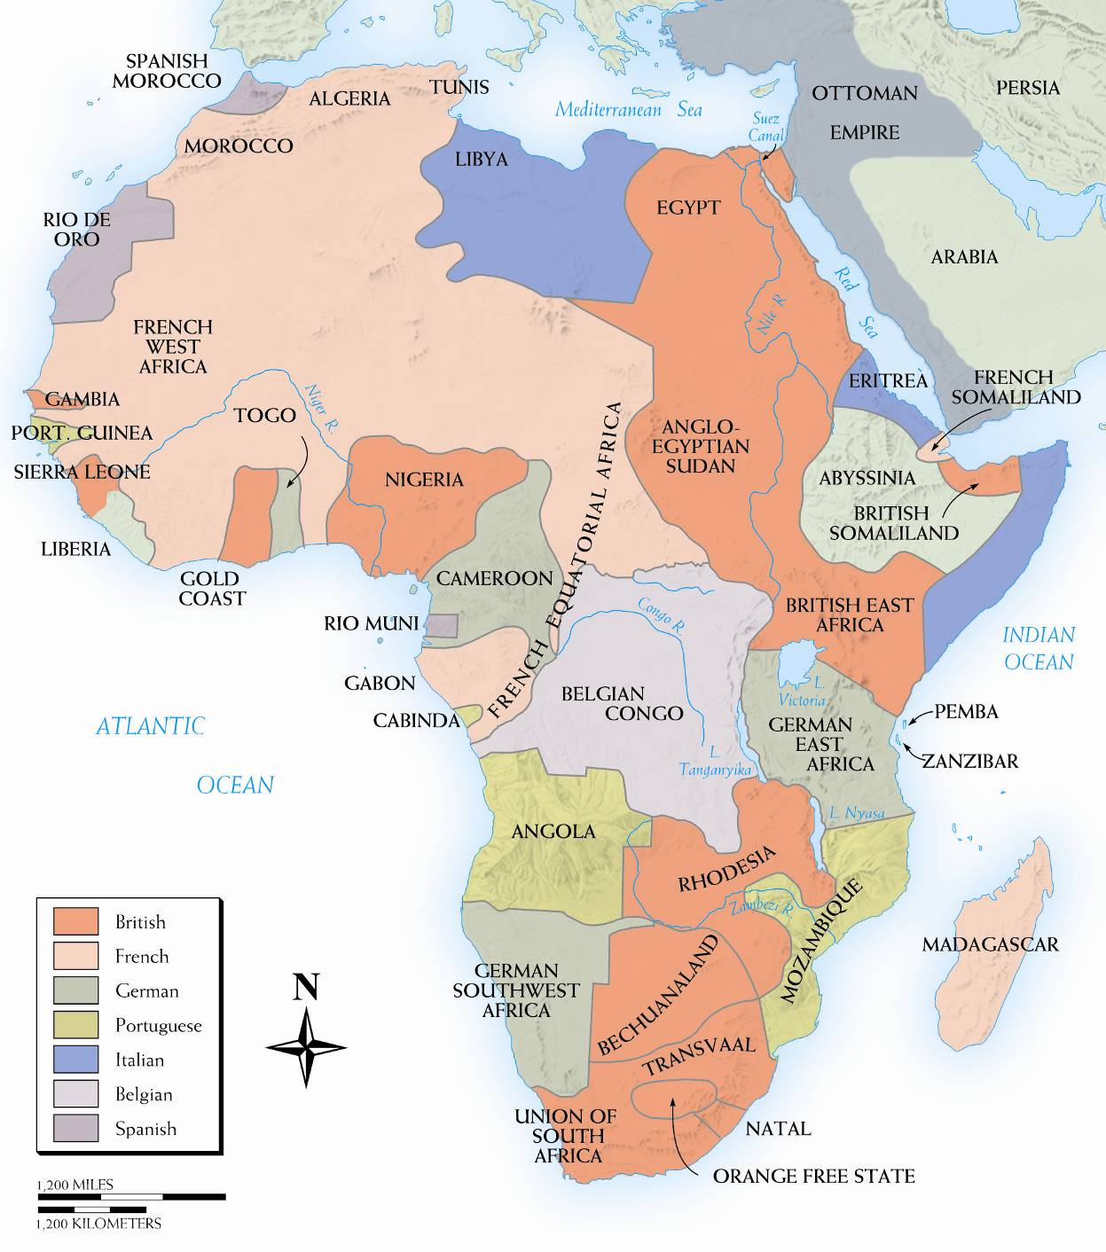
Map 25–2 PARTITION OF AFRICA, 1880–1914 Before 1880, the European presence in Africa was largely the remains of early exploration by old imperialists and did not penetrate the heart of the continent. By 1914, the occupying powers included most large European states; only Liberia and Abyssinia (Ethiopia) remained independent.

Slide 10
North Africa
Technically part of Ottoman Empire.
Pressure applied diplomatically and through investments and loans to exert influence on the area.

Slide 11
Egypt
Sold cotton as a cash crop on the international market.
Financed the Suez Canal through foreign loans.
The bankrupt government was overthrown by the army in 1881
Britain defeated the army and installed administrators to ensure repayment of their loans for the Suez Canal and access to the path to India.

Slide 12
Belgian Congo-”King Leopold’s Ghost”
King Leopold financed Stanley’s African explorations on his behalf.
Berlin Conference codified his “treaties” with local tribes.
Leopold cultivated the image of a humanitarian ruler while imposing brutal conditions on residents of the Congo.
In thirty years as ruler, approximately one-half of the residents of the Congo were victims of murder, exploitation, starvation, and disease.

Slide 13
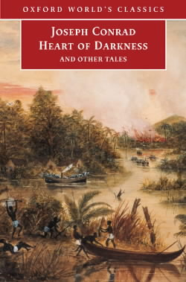
Joseph Conrad: Heart of Darkness

Slide 14
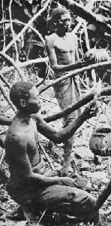
Harvesting Rubber

Slide 15
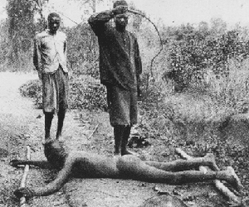
Punishing “Lazy” Workers

Slide 16
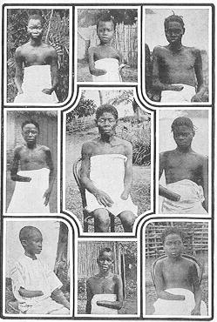
5-8 Million Victims! (50% of Popul.)
It is blood-curdling to see them (the soldiers) returning with the hands of the slain, and to find the hands of young children amongst the bigger ones evidencing their bravery...The rubber from this district has cost hundreds of lives, and the scenes I have witnessed, while unable to help the oppressed, have been almost enough to make me wish I were dead... This rubber traffic is steeped in blood, and if the natives were to rise and sweep every white person on the Upper Congo into eternity, there would still be left a fearful balance to their credit. -- Belgian Official

Slide 17
Southern Africa
Important resources include fertile pastures and farm land, deposits of coal, iron ore, gold, diamonds, and copper.
Partially inhabited by the Afrikaners, or Boers, descendents of Dutch settlers
After a series of bloody wars, the British arranged with the Boers for a white-only ruling class.
Apartheid
  “Separateness” – the policy that segregated non-whites and granted virtually no civil rights in South Africa.

Slide 18
Asia
Open Door Policy
  Proposed by the US, opposed foreign annexations in China and equal opportunity to all nations to trade there.
The emergence of Japan as a great power frightened the other powers interested in China.
The United States exerted great influence in the Western Hemisphere by virtue of the Monroe Doctrine.
After the Spanish American War, the United States had influence over Cuba, Puerto Rico, part of the Philippines, Samoa, and would soon control Hawaii.
The Ottoman Empire remained vulnerable and had been in decline since the late seventeenth century.

Slide 19
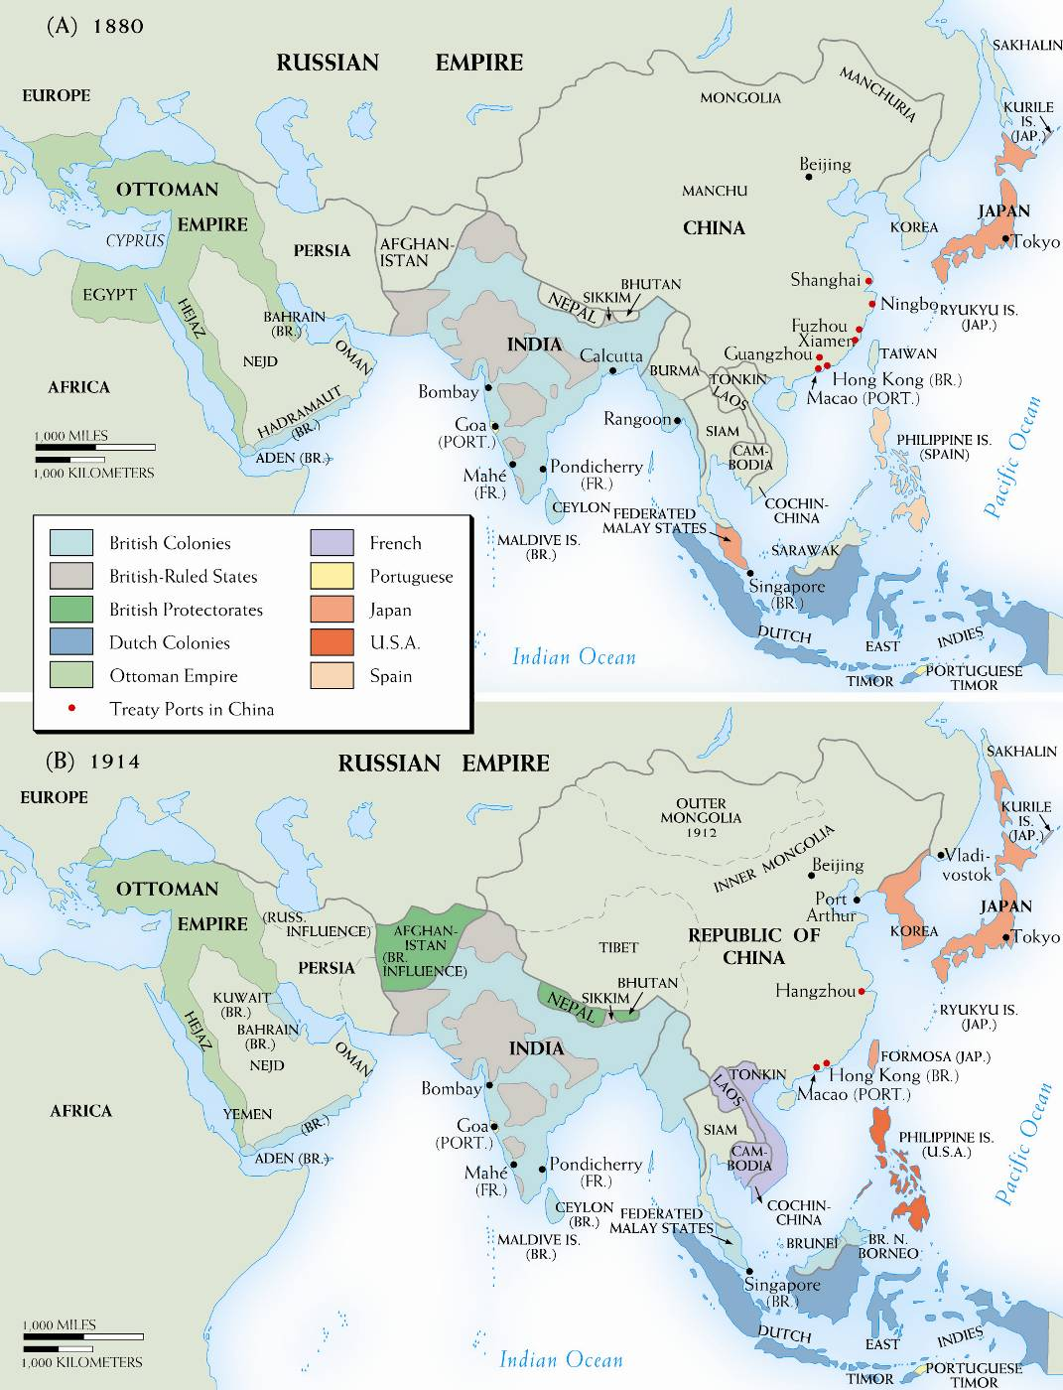
Map 25–3 ASIA, 1880–1914 As in Africa, the decades before World War I saw imperialism spread widely and rapidly in Asia. Two new powers, Japan and the United States, joined
the British, French, and Dutch in extending control both to islands and to the mainland and in exploiting an enfeebled China.

Slide 20
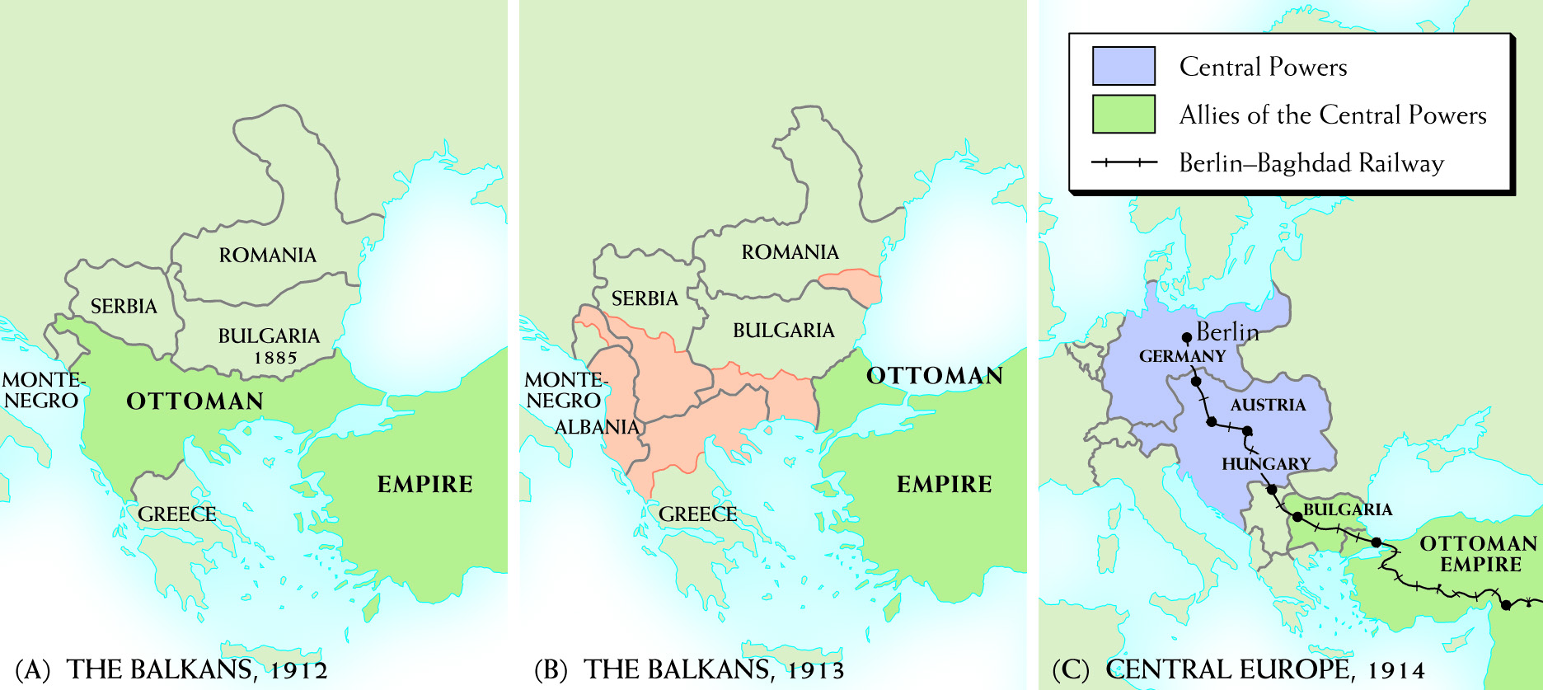
Map 25–4 THE BALKANS, 1912–1913 Two maps show the Balkans (a) before and (b) after the two Balkan wars; note the Ottoman retreat. In (c), we see the geographical relationship of the Central Powers and their Bulgarian and Turkish allies.

Slide 21
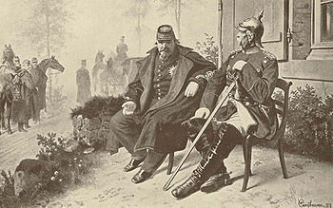


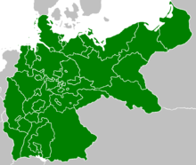
Emergence of the German Empire and the Alliance Systems (1873-1890)
The appearance of a German Empire upset the balance of power in Europe.
The German Empire was a nation of great wealth, industrial capacity, military power, and population.
The forces of nationalism threatened Austria with disintegration.
After its defeat in the Franco-Prussian War the French were no longer a dominant Western European power and were concerned about Prussia.

Slide 22
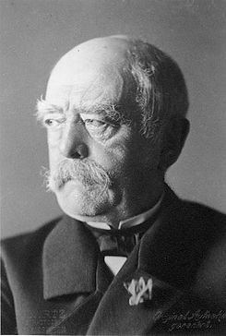
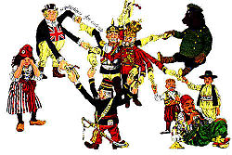
Bismarck’s Leadership
Bismarck wanted to avoid war and preserve Germany’s territorial integrity and established the Three Emperors’ League with Austria and Russia.
After the League collapsed, The Treaty of San Stefano freed the Balkan Slavic states from Ottoman rule and the Russians gained some territory.
The 1878 Congress of Berlin settled the Eastern Question unsatisfactorily, and the south Slavic question remained a threat to European peace.
Germany and Austria agreed to a mutual defense treaty from Russia known as the Dual Alliance, which was later joined by Italy. By Bismarck’s retirement he was allied with Austria, Russia, and Italy while on good terms with Britain.
The ascension of the pugilistic and nationalistic William II threatened future European stability.
A main objective of Bismarck's was to prevent other major powers allying with France.

Slide 23
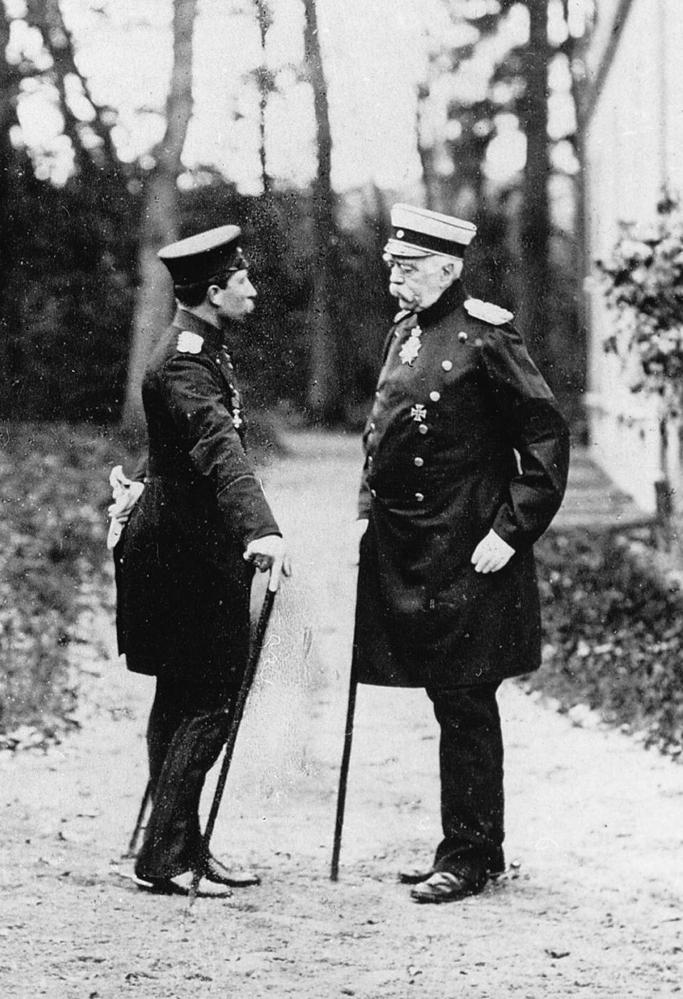
Bismarck and the young Kaiser William II meet in 1888. The two disagreed over many issues, and in 1890 William dismissed the aged chancellor.
German Information Center

Slide 24
Forging the Triple Entente
(1890-1907)
France, concerned with security against Germany, invested in Russia which in turn proffered a mutual defense treaty against Germany.
William II instigated a naval build-up in an attempt to emulate Britain, which simply produced more ships.
The 1904 Entente Cordiale represented a major step in aligning Britain with France.
After Germany attempted to pressure France and the international community into colonial concessions in Germany, Britain and France arranged an alliance that made their military forces mutually dependent by 1914.
In 1907, Britain concluded an agreement much like the Entente Cordiale, this time with Russia.
The Triple Entente of Britain, Russia, and France were aligned against the Triple Alliance of Germany, Austria-Hungary, and the unreliable Italy.

Slide 25
The Road to War (1908-1914)
Austria annexed Bosnia. The actions strained relations between Russia, who had an agreement with Austria, and France and Britain. At the same time Germany pledged to support Austria, putting Austria in control of German foreign policy.
After the Second Moroccan Crisis, Britain and France moved closer together creating a de facto alliance.
After Two Balkan Wars, Austria concluded Serbian territorial expansion by threatening to use force in Albania. The Alliance system was bending under the strain of international pressures.

Slide 26
Sarajevo and the Outbreak of War (June-August 1914)
The heir to the Austrian throne, Archduke Franz Ferdinand, is assassinated in Sarajevo with the aid of Serbian nationalists.
The assassination caused outrage in Europe, but Austria was slow to respond to Serbia, which it was determined to invade. Germany pledged to support Austria and Russia, building up its military, was likely to defend Serbia while drawing in France.
Austria mobilized, Russia mobilized, Germany declared war on Russia and the next day declared war on France. Germany invaded Belgium, drawing Britain into the war, Germany invaded France, and then Britain declared war on Germany.

Slide 27
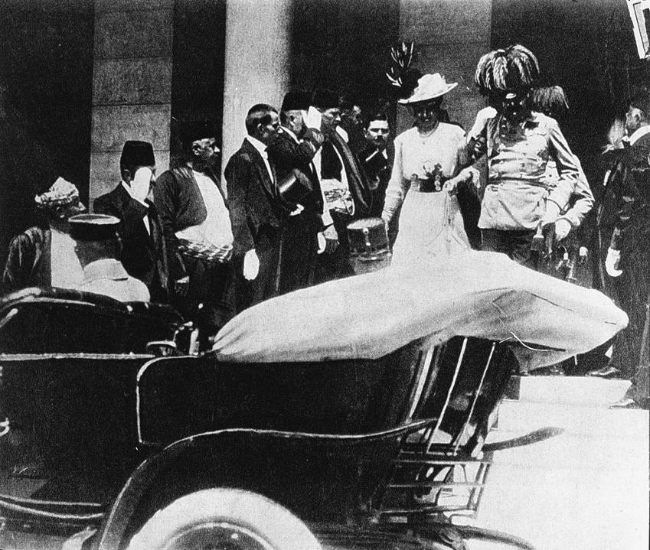
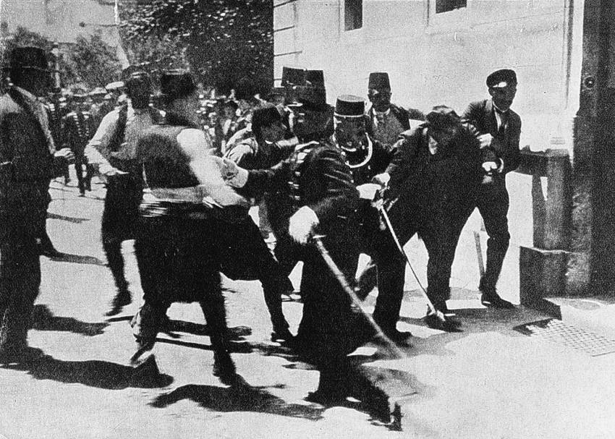
Above: The Austrian archduke Francis Ferdinand and his wife in Sarajevo on June 28, 1914. Later in the day the royal couple were assassinated by young revolutionaries
trained and supplied in Serbia, igniting the crisis that led to World War I. Below: Moments after the assassination the Austrian police captured one of the assassins.
Brown Brothers

Slide 28
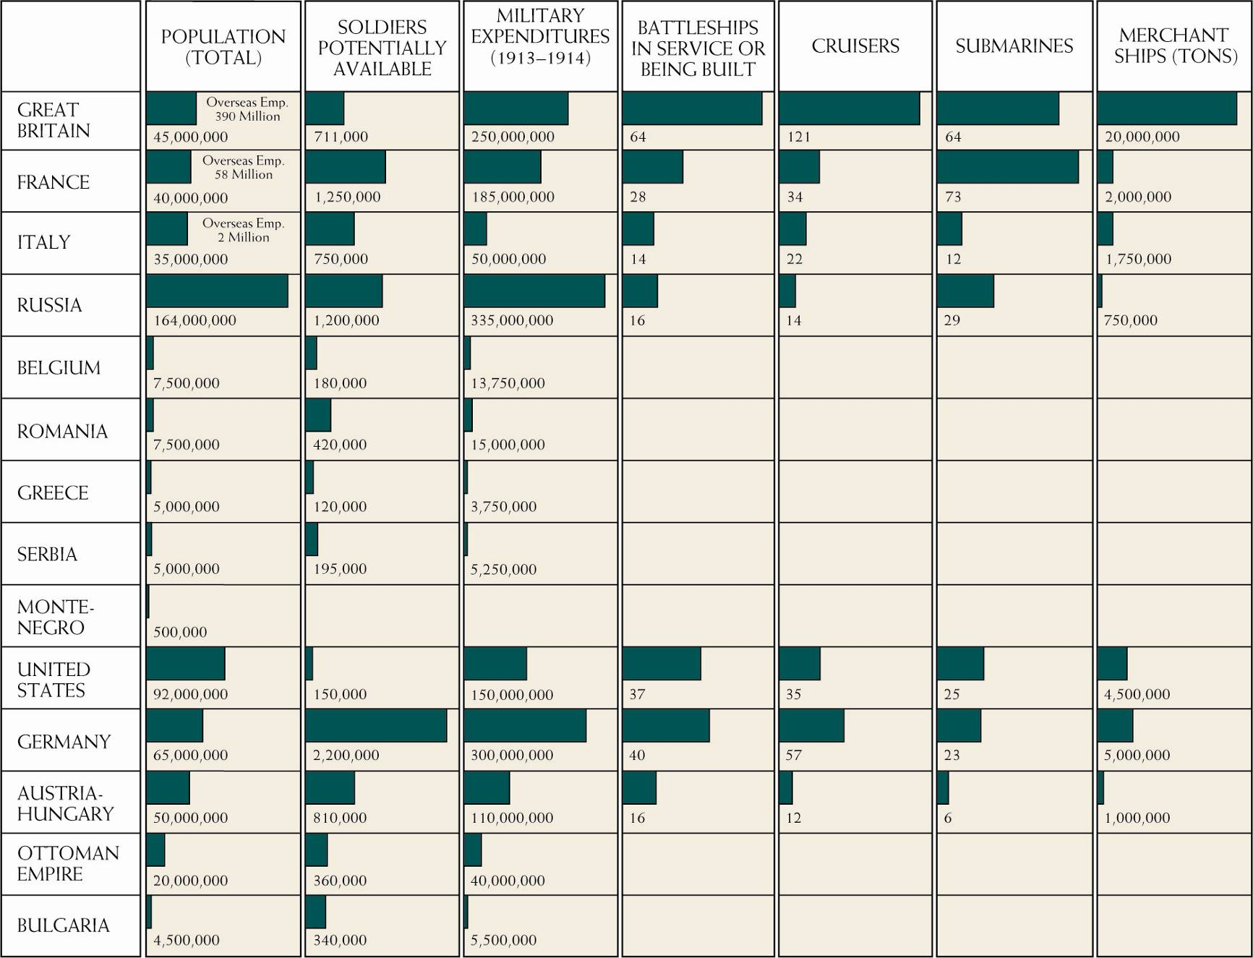
FIGURE 25–1 Relative strengths of the combatants in World War I.

Slide 29
Strategies and Stalemate: 1914–1917
All over the Continent people welcomed war, unaware of the horrors of modern warfare.
After initial German and French failures on the Western front, the war devolved into trench warfare over a few hundred yards of land.
The British introduced the tank in 1916 which was the answer to the terrible effectiveness of the machine gun defensively.
In the East, both sides appeared to nationalistic sentiment in the areas the enemy held. Some of the groups roused included the Irish, the Flemings, the Poles, the Czechs, the Slovaks, the Slavs, and Muslims.
The Germans introduced submarine warfare, especially around the British Isles, to try and cut off enemy supply lines to the Continent.
Continued German submarine warfare, including sinking the United States liner Lusitania, led the United States to declare war on Germany in 1917.

Slide 30
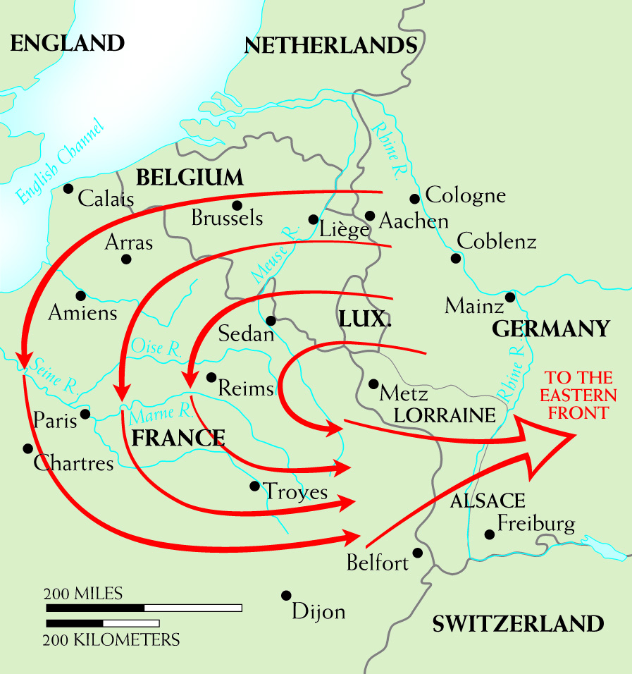
Map 25–5 THE SCHLIEFFEN PLAN OF 1905 Germany’s grand strategy for quickly winning the war against France
in 1914 is shown by the wheeling arrows on the map. In the original plan, the crushing blows at France were to be followed by the release of troops for use against Russia on
Germany’s eastern front. The plan, however, was not adequately implemented, and the war on the western front
became a long contest in place.

Slide 31
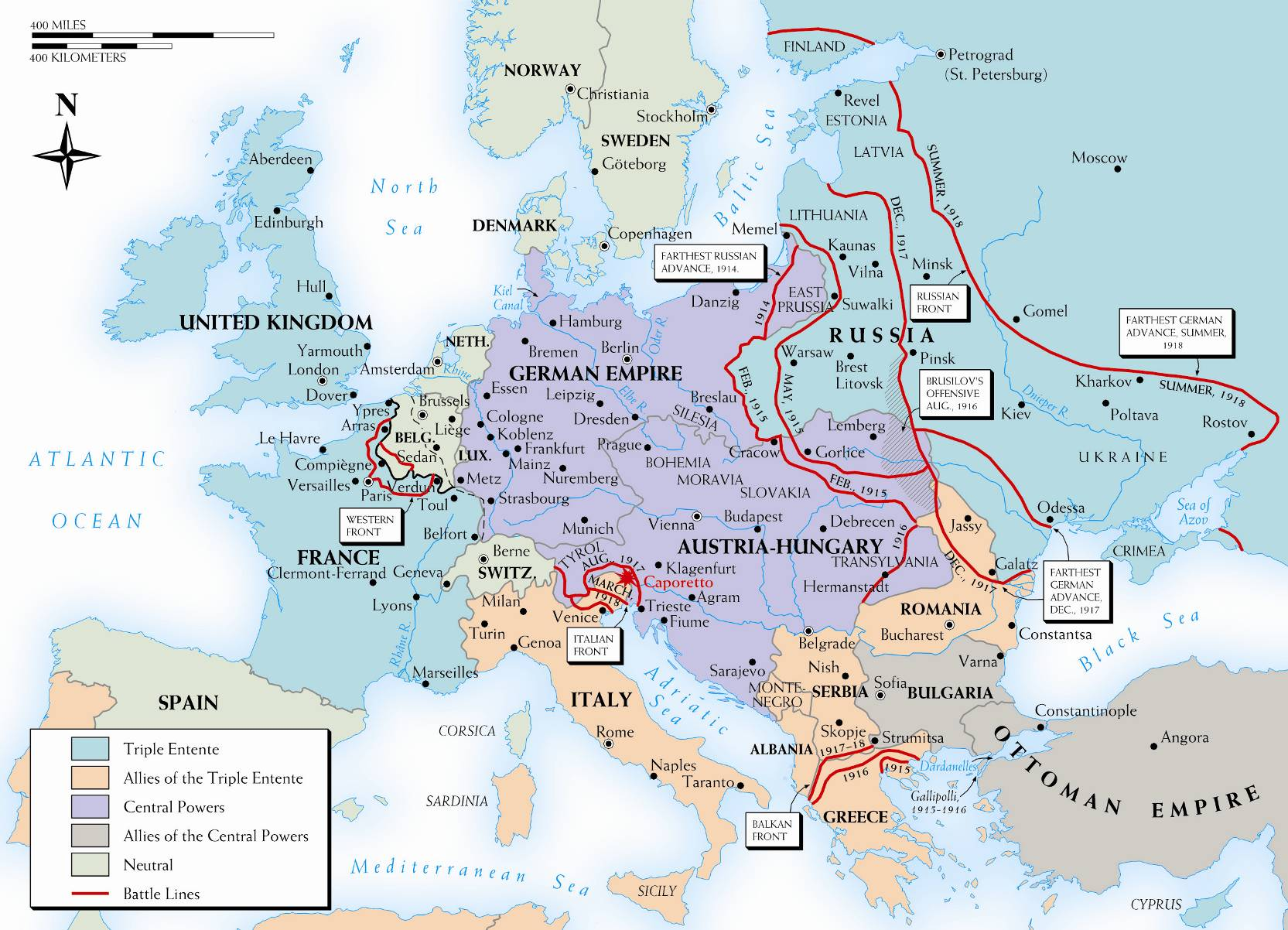
Map 25–6 WORLD WAR I IN EUROPE Despite the importance of military action in the Far East, in the Arab world, and at sea, the main theaters of activity in World War I were in the European areas.

Slide 32
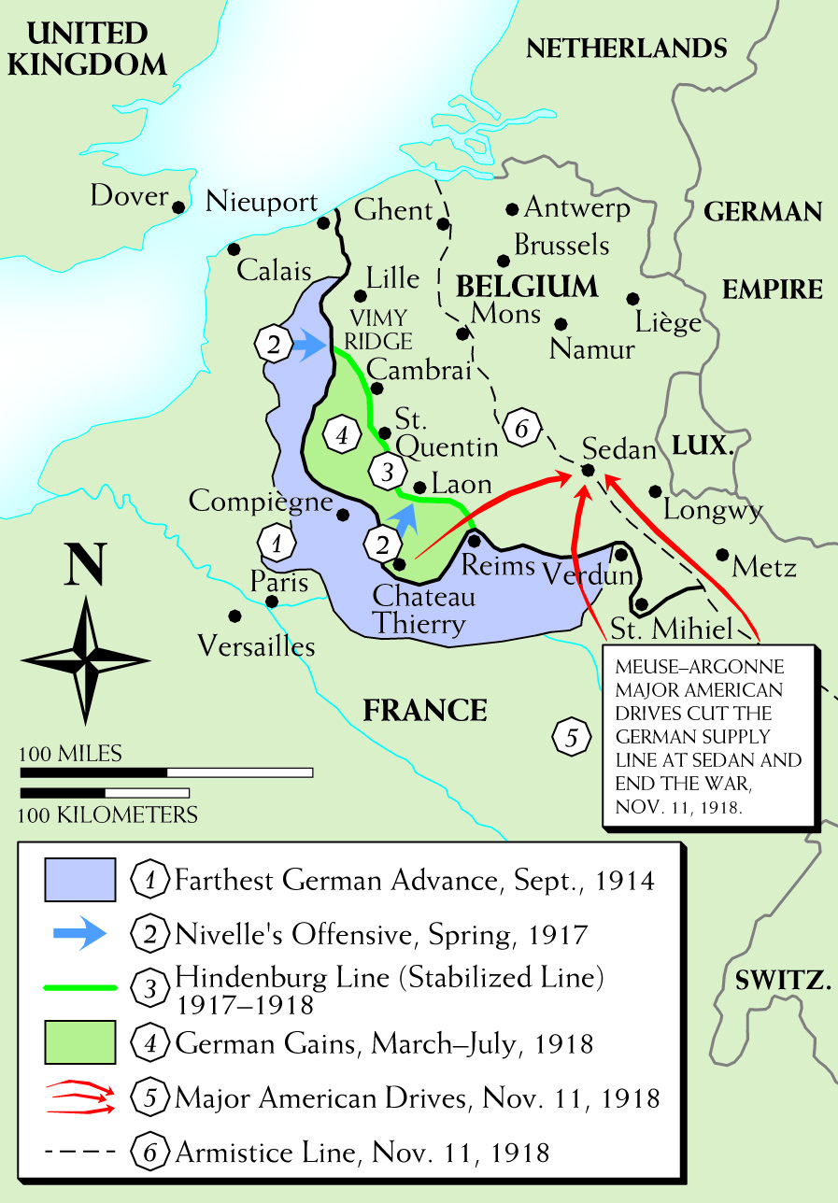
Map 25–7 THE WESTERN FRONT, 1914–1918 This map shows the crucial western front in detail.

Slide 33
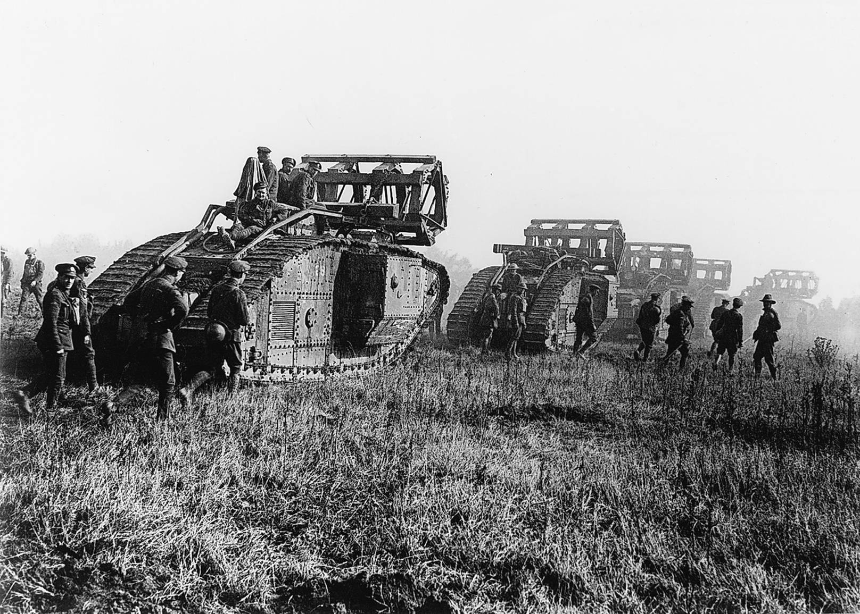
British tanks moving toward the Battle of Cambrai in Flanders late in 1917. Tanks were
impervious to machine-gun fire. Had they been used in great numbers, they might have
broken the stalemate in the west.
Bildarchiv Preussischer Kulturbesitz

Slide 34
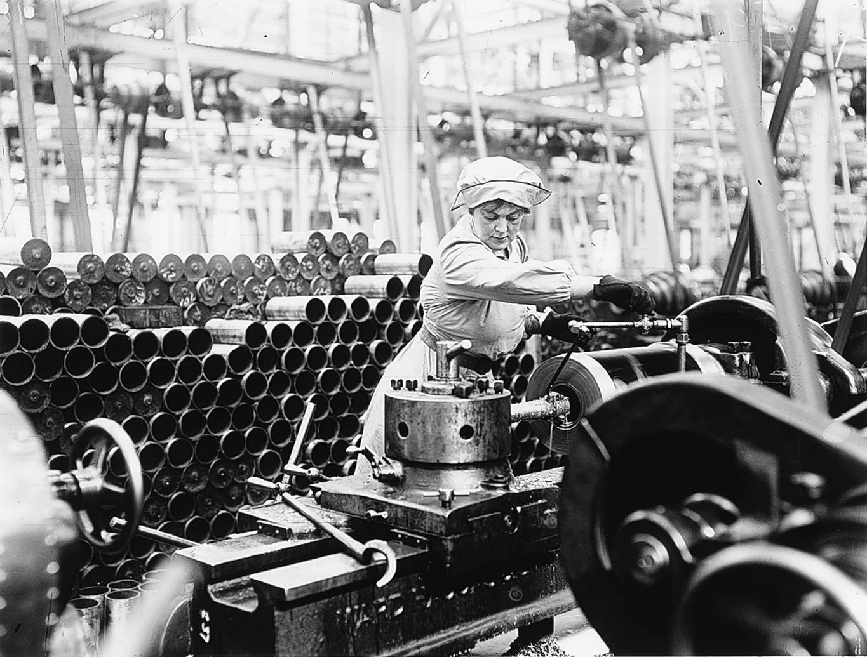
Women munitions workers in England. World War I demanded more from the civilian
populations than had previous wars, resulting in important social changes. The demands of the munitions industries and a shortage of men (so many of whom were in uniform) brought many women out of traditional roles at home and into factories and other war-related work.
Getty Images Inc.–Hulton Archive Photos

Slide 35
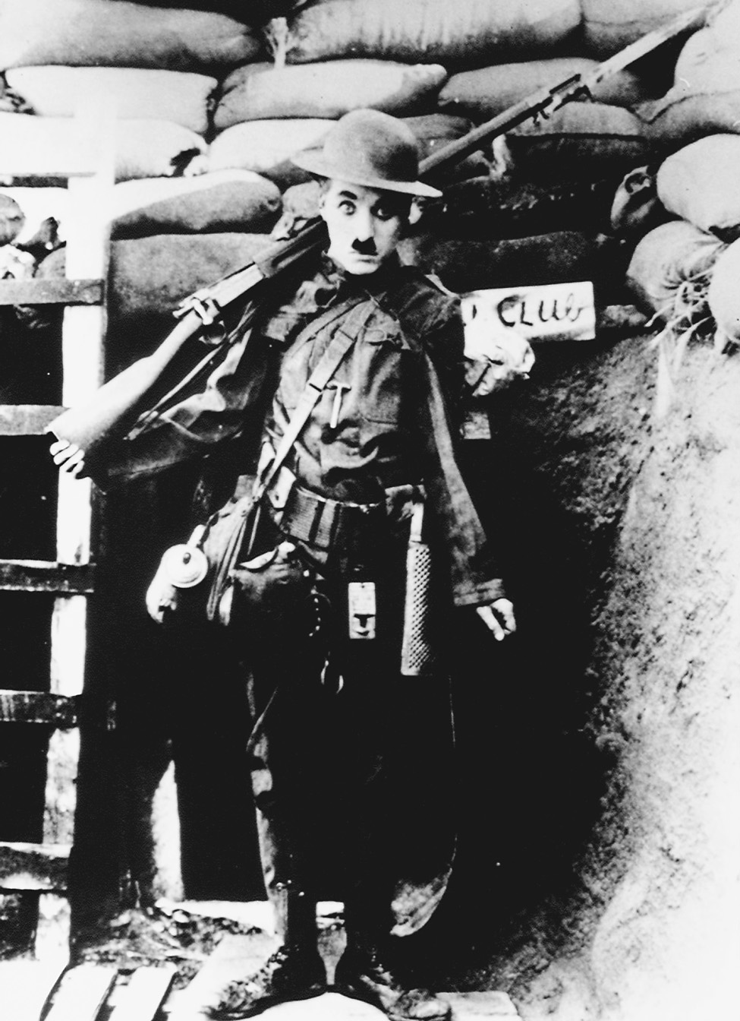
Charlie Chaplin in Shoulder Arms.
© Sunset Boulevard/Corbis Sygma

Slide 36
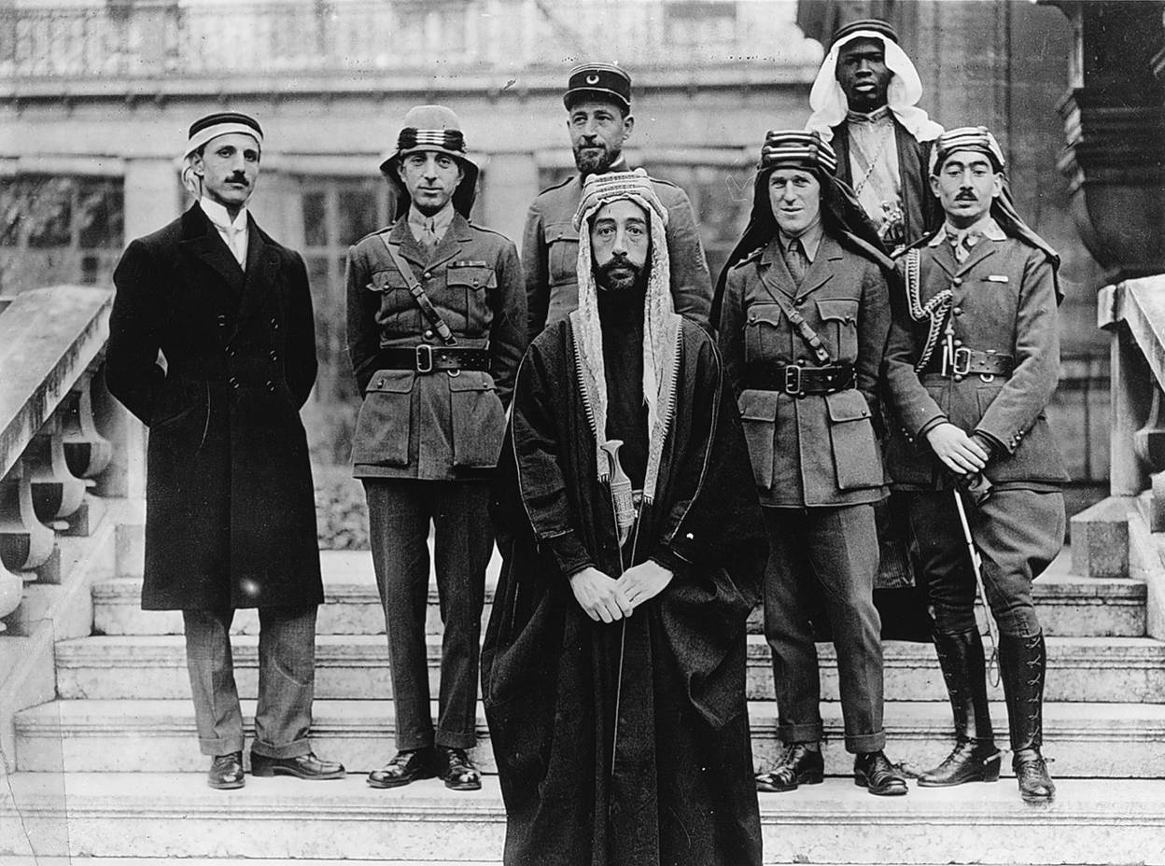
The Allies promoted Arab efforts to secure independence from Turkey in an effort to remove Turkey from the war. Delegates to the peace conference of 1919 in Paris included British colonel T. E. Lawrence, who helped lead the rebellion, and representatives from the Middle Eastern region. Prince Feisal, the third son of King Hussein, stands in the foreground of this picture; Colonel T. E. Lawrence is in the middle row, second from the right; and Brigadier General Nuri Pasha Said of Baghdad is second from the left.
CORBIS/Bettmann

Slide 37
The Russian Revolution
The incompetent government of Nicholas II led to internal disorder in Russia.
Peasant discontent plagued the countryside.
In the absence of Nicholas II, incompetent government officials attempted to keep order as the members of Russia’s parliament remained unsatisfied.

Slide 38


The Russian Revolution
→
Original Russian Revolution slides by Scott Masters
Crestwood College as inserted in Chapter 25 notes by Mr. Flint
Notes:
38

Slide 39
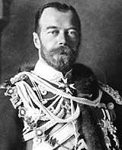
Pre-Revolutionary Russia
Only true autocracy left in Europe
No type of representative political institutions
Nicholas II became tsar in 1884
Believed he was the absolute ruler anointed by God
Russo-Japanese War (1904) – defeat led to pol. instability
Notes:
39

Slide 40
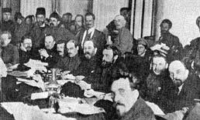
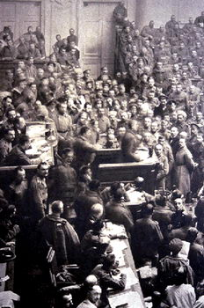
conditions deteriorated, rev. became possible, esp. w/ Lenin’s involvement
he had gravitated towards the Social Dem. Workers’ Party of George Plekhanov – they believed in dialectical materialism and thus favoured modernization/capitalism (which the czars also favoured as a measure to catch up w/ the w. Europe, esp. after the Crimean and Russo-Japanese Wars)
Notes:
40

Slide 41
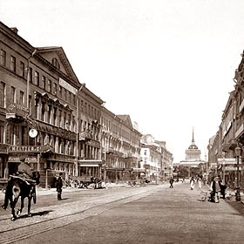
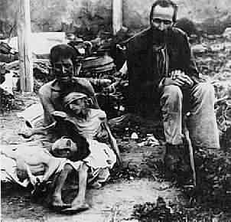
The Revolution of 1905
Rapid growth of (discontented) working class
Vast majority of workers concentrated in St. Petersburg and Moscow
Little help from the countryside: impoverished peasants – Populist Movements of the 1870s and later had done little to improve their lot
  No individual land ownership
  Rural Famine
Notes:
41

Slide 42
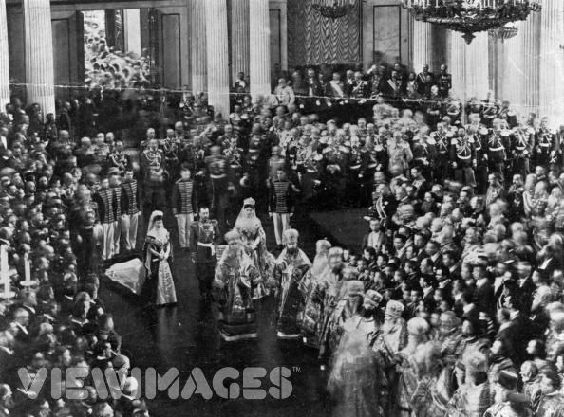
Conservatism Continues:
1905-1917
Tsar paid no attention to the Duma; it was harassed and political parties suppressed – only token land reform was passed
Nicholas was personally a very weak man; he became increasingly remote as a ruler
Numerous soviets thus began to appear
Notes:
42

Slide 43
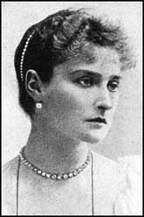
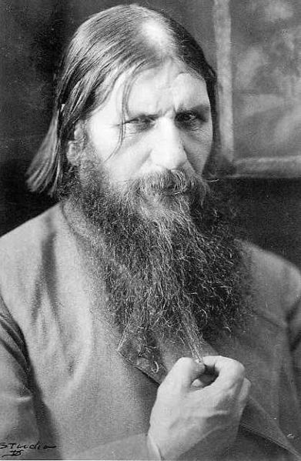
Alexandra: The Power Behind the Throne
Even more blindly committed to autocracy than her husband
She was under the influence of Rasputin
Origins of Rasputin’s power - ?
Scandals surrounding Rasputin served to discredit the monarchy
Notes:
43

Slide 44
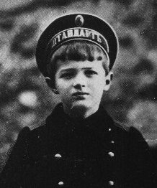
Alexis: Alexandra’s Son with Hemophilia
Notes:
44

Slide 45
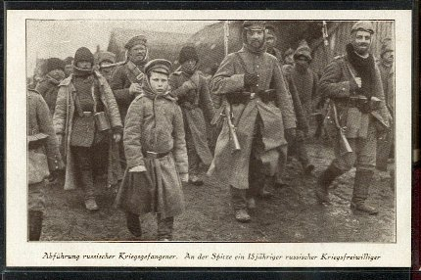
World War I: “The Last Straw”
War revealed the ineptitude and arrogance of the country’s aristocratic elite
Corrupt military leadership had contempt for ordinary Russian people
Average peasants had very little invested in the War
Notes:
45

Slide 46
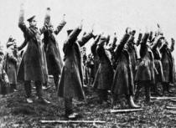
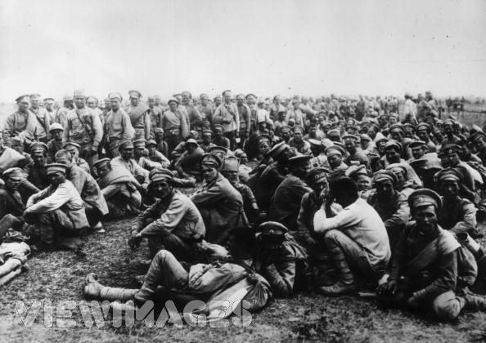
World War I (cont)
ill-trained, ineffective officers, poorly equipped (Russ. was not ready for ind. war) – the result was mass desertions and 2 million casualties by 1915
Result: Chaos and Disintegration of the Russian Army
Battle of Tannenberg (August, 1914) – massive defeat at hands of Hindenburg and Ger.
Notes:
46

Slide 47
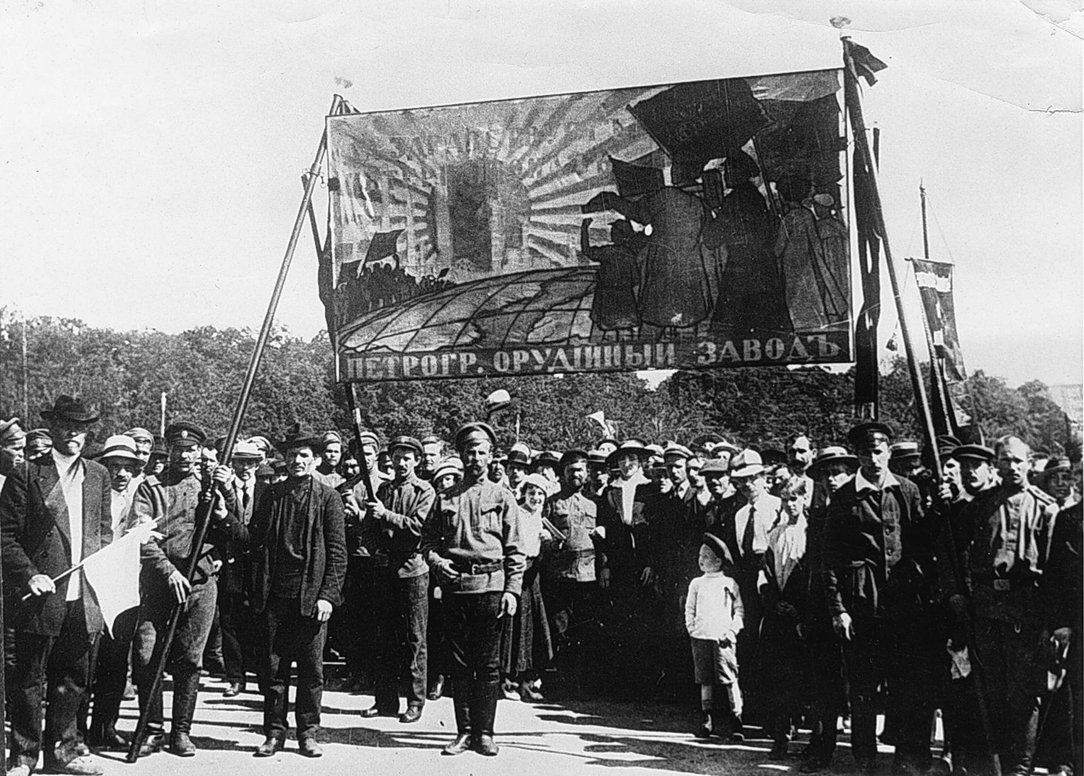
Petrograd munitions workers demonstrating in 1917.
Ria-Novosti/Sovfoto/Eastfoto

Slide 48
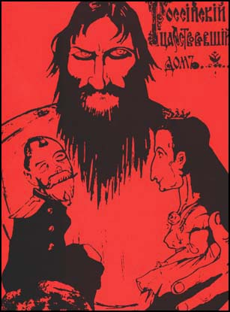
The Collapse of the Imperial Government
Nicholas left for the Front—September, 1915
Alexandra and Rasputin throw the government into chaos
Alexandra and other high government officials accused of treason
Notes:
48

Slide 49
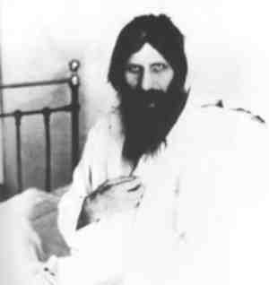
The Collapse of the Imperial Government (cont)
Rasputin assassinated in December of 1916
Complete mismanagement of the wartime economy
ind. production plummeted, inflation and starvation were rampant, and the cities were overflowing w/ refugees
they became a hotbed for pol. activism, and this was ignited by serious food shortages in March 1917, esp. in St. Petersburg
Notes:
49

Slide 50
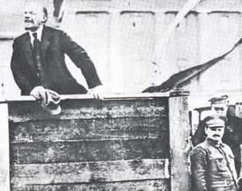
The Two Revolutions of 1917
The March Revolution (March 12)
The November Revolution (November 6)
Notes:
50

Slide 51
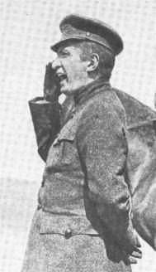
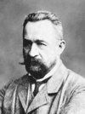
The March Revolution
Origins: Food riots/strikes
Duma declared itself a Provisional Government on March12
Tsar ordered soldiers to intervene; instead they joined the rebellion…the Tsar thus abdicated on March 17
the Menshevik Alexander Kerensky headed the Provisional Government, along w/ Prince Lvov
  Very Popular Revolution
  Kerensky favoured gradual socialist reform/ saw the war effort as #1 priority
Notes:
51

Slide 52
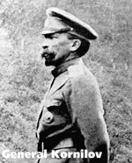
Kornilov Affair
General Kornilov attempted to overthrow Provisional Government with military takeover
To prevent this takeover, Kerensky freed many Bolshevik leaders from prison and supplied arms to many revolutionaries
Notes:
52

Slide 53
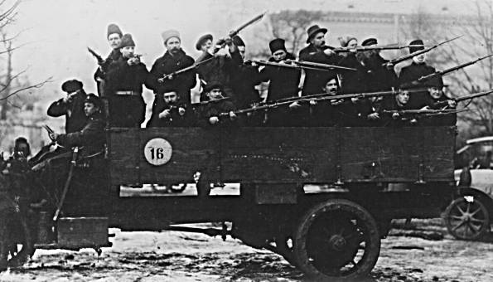
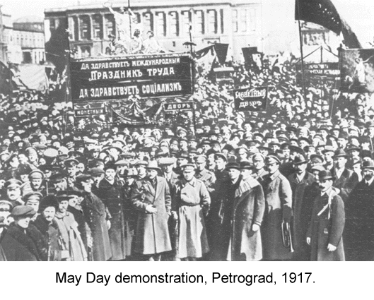
The Petrograd Soviet
    leftists in St. Petersburg formed the Petrograd Soviet, which they claimed to be the legit. gov’t
    Ger. was aware of the Russ. situation and began to concentrate on the W. Front
    Ger. even played a role in returning Lenin to Russia, so he could foment rev.
      Having been granted “safe passage”, Lenin returned in April 1917
Notes:
53

Slide 54
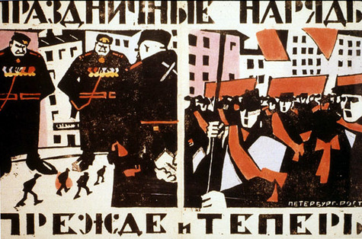
Soviet Political Ideology
More radical and revolutionary than the Provisional Government
Most influenced by Marxist socialism
Emulated western socialism
Two Factions
-- “Mensheviks”
-- “Bolsheviks”
Notes:
54

Slide 55
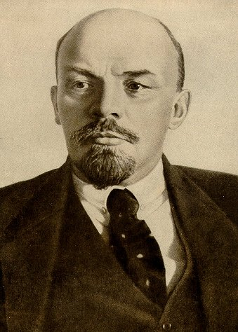
Founder of Bolshevism: Vladimir Lenin
His Early Years
--Exiled to Siberia in 1897
Committed to Class Struggle and Revolution
Moved to London in 1902 and befriended Leon Trotsky
What is to be Done?
  vanguard is required to lead the rev. (thus rev. from above) → this split the SDWP in 2
Notes:
55

Slide 56

Lenin Steps into This Vacuum
Amnesty granted to all political prisoners in March of 1917
Lenin’s arrival in Petrograd
A tremendously charismatic personality
“Peace, Land, Bread”
“All Power to the Soviets”
He preached that the war was a capitalist/imperialist war that offered no rewards for the peasants/workers; he also felt the war was over w/ the czar’s abdication
Bolshevik party membership exploded; their power was consolidated
Notes:
56

Slide 57

    Lenin formed the Military-Revolutionary Council and in May 1917 he urged the Pet. Soviet to pass Army Order # 1
      This gave control of the army to the common soldiers; discipline thus collapsed, and Kerensky was undermined
Notes:
57

Slide 58


The November Revolution
Nov. 6, 1917…
this was the ideological aspect of the rev., w/ the coup itself planned by Leon Trotsky, who had gained the confidence of the army (= the “Red Miracle”)
Lenin went on to consolidate his power in Jan. 1918 when he disbanded the Constituent Assembly (had replaced the Duma) – the Bolsheviks had not gained a majority there in late Nov. elections - Russ. dem. thus terminated → a Council of People’s Commissars was created
All private property was abolished and divided among the peasantry
Largest industrial enterprises nationalized
Notes:
58

Slide 59


November Revolution (cont)
Political Police organized: CHEKA
Revolutionary army created with Trotsky in charge = “Red Army”
Bolshevik Party renamed Communist Party in March of 1918
Notes:
59

Slide 60

November Revolution (cont)
Lenin’s 1st task was to get Russia out of the war so he could concentrate on internal reform…
The Treaty of Brest-Litovsk negotiated with the Germans, giving them much Russian territory, population, and resources
Civil War followed, 1917-1920
→“Reds” versus “Whites”
Complete breakdown of Russian economy and society
Notes:
60

Slide 61

Interpreting the Russian Revolution
The official Marxist interpretation
→ The importance of a permanent international revolution
Function of Russian History and Culture
Imposed Revolution on an unwilling victim
A Social Revolution…
Notes:
61

Slide 62
Notes:
62

Slide 63
The Provisional Government
After the abdication of the tsar, the provisional government continued to support the war effort.
After one failed coup attempt, a second coup led by Lenin and Trotsky was successful in November.

Slide 64
The Communist Dictatorship
The government nationalized the land and turned it over to peasants.
Russia was taken out of the war.
The Treaty of Brest-Litovsk yielded Poland, Finland, the Baltic states, and Ukraine to Germany.
After a three year battle between the Red Army, controlled by Lenin, and the White Russians, who opposed the revolution, Lenin’s Bolshevik forces were in firm control.

Slide 65
The End of World War I
With Russia out of the war Germany, in control of important European resources like food, could focus on the western front.
The deadlock continued through 1917 although American involvement would change the tide of the war.

Slide 66
Germany’s Last Offensive
In March, the Germans mounted a final unsuccessful offensive.
With Austria, Bulgaria, and Turkey essentially out of the war, the Germany army was finished.
Germany set up a new government to be established on democratic principles and asked for peace based on the Fourteen Points that were the American’s war aims.
  Fourteen Points included self-determination for nationalities, open diplomacy, freedom of the seas, and the establishment of a League of Nations to keep the peace.

Slide 67
The Armistice
Germans felt betrayed by the terms of the treaty
Casualties on both sides came to ten million dead and over twenty million wounded.
The financial resources of Europe were badly strained and much of Europe was in debt to Americans.
The Great War undermined ideals of Enlightenment progress and humanism.
The aftermath of the Great War paved the way for the Second World War and much of the horrors of the rest of the century.

Slide 68
The End of the Ottoman Empire
Its new leaders, the Young Turks, saw their nation divided up amongst Britain and France. In its wake was the new republic of Turkey.
The Arab portions of the old empire were divided into a collection of artificial states with no historical reality governed by foreign administrators.

Slide 69
Obstacles the Peacemakers Faced
Public opinion was a major force in politics.
Many of Europe’s ethnic groups agitated for attention.
Wilson’s idealism conflicted with the practical war aims of the victorious powers.
Some nations had competing claims for land.
The victorious nations feared the spread of Bolshevism.

Slide 70

Britain’s David Lloyd George, France’s Georges Clemenceau, and America’s Woodrow Wilson (l. to r.) were the dominant figures at the Paris peace conference in 1919.
© Bettmann/CORBIS

Slide 71
The Peace
The Soviet Union and Germany were excluded from the peace conference for the Treaty of Versailles.
League of Nations was established.
Colonial areas would be encouraged to advance towards independence.
Germany ceded Alsace-Lorraine to France, part of the Rhine was declared a demilitarized zone, and German military limitations.
Germany was forced to pay all of the damages to the Allies, known as reparations and the war guilt clause gave Germany sole responsibility for the war.

Slide 72
“Art” of
World
War I

Slide 73

“A Street in Arras”
John Singer Sargent, 1918

Slide 74

“Oppy Wood” – John Nash, 1917

Slide 75

“Those Who Have Lost Their Names”
Albin Eggar-Linz, 1914

Slide 76

“Gassed and Wounded”
Eric Kennington, 1918

Slide 77

“Paths of Glory”
C. R. W. Nevinson, 1917

Slide 78

German Cartoon:
“Fit for active service!”, 1918

Slide 79





1918 Flu Pandemic:
Depletes All Armies
50,000,000 – 100,000,000 died

Slide 80


11 a.m., November 11, 1918
The Armistice is Signed!

Slide 81

9,000,000 Dead

Slide 82
World War I Casualties

Slide 83

Turkish Genocide Against Armenians
A Portent of Future Horrors to Come!

Slide 84

Territorial Changes
As a Result of
World War I
Ms. Susan M. Pojer
Horace Greeley HS Chappaqua, NY
Notes:
84

Slide 85

WW 1 Secret Treaties:
Sykes-Picot Agreement [1916]
Ms. Susan M. Pojer
Horace Greeley HS Chappaqua, NY
Notes:
85

Slide 86
Balfour Declaration [1917]
Foreign Office
November 2nd, 1917
Dear Lord Rothschild.
I have much pleasure to convey to you, on behalf of His Majesty’s Government, the following declaration of sympathy with Jewish Zionist aspirations {hopes} which has been submitted to, and approved by, the Cabinet.
“His Majesty’s Government view with favor the establishment in Palestine of a national home for the Jewish people, and will use their best endeavors to facilitate {assist} the achievement of this object, it being clearly understood that nothing shall be done which may prejudice the civil and religious rights of existing non-Jewish communities in Palestine, or the rights and political status enjoyed by Jews in any other country.”
I should be grateful if you would bring this declaration to the knowledge of the Zionist Federation.
Yours sincerely,
ARTHUR JAMES BALFOUR
British Foreign Secretary
Ms. Susan M. Pojer
Horace Greeley HS Chappaqua, NY
Notes:
86

Slide 87

British Palestine Mandate in 1923
Ms. Susan M. Pojer
Horace Greeley HS Chappaqua, NY
Notes:
87

Slide 88

The Middle East in the 1920s
Ms. Susan M. Pojer
Horace Greeley HS Chappaqua, NY
Notes:
88

Slide 89

German Pacific Colonies [1914]
Ms. Susan M. Pojer
Horace Greeley HS Chappaqua, NY
Notes:
89

Slide 90

League of Nations Mandates in Africa
Ms. Susan M. Pojer
Horace Greeley HS Chappaqua, NY
Notes:
90

Slide 91

New Nations &Territories After WW I
Ms. Susan M. Pojer
Horace Greeley HS Chappaqua, NY
Notes:
91

Slide 92
Evaluating the Peace
The peace violated some idealistic principles.
It left many minorities outside the borders of their national homelands.
By excluding Germany and Russia, the settlement ignored the reality of their European influence.
Germany felt cheated.
Ms. Susan M. Pojer
Horace Greeley HS Chappaqua, NY

